Slide 1
08 - LOGISTIC
REGRESSION
Machine Learning

Slide 2
Course Overview:
1.1 - Python Review
1.2 - Numpy
1.3 - Pandas
1.4 - Seaborn
2.1 - ML Intro
2.2 - Linear Regression
2.3 - Logistic Regression
2.4 -Naïve Bayes Classifier
2.5 - KNN
2.6 - Decision Trees
3.1 – Ensembling Learning
3.2 - Neural Networks
4.* - Natural Language Processing (NLP)
5.* Competition Tips & Final Thoughts

Slide 3
Review
01
Metrics
Logistic Regression
TABLE OF CONTENTS
03
02
Implementation
04

Slide 4
01
Classification Review

Slide 5
Types of Supervised Machine Learning Problems
Regression
Classification
Predicting numerical values as the outputs given certain inputs.
Categorizing objects with given features into certain classes.
Notes:
response/target variable continuous vs categorical. Quantitative vs qualitative.
e.g. eye color = categorical; height = quantitative; spam/not spam = categorical;

Slide 6
Types of Classification Problems
Binary
Multiclass
(Multinomial)
Multi-Label
Imbalanced
Input falls into either of two categories (e.g. true/false).
There are more than two possible categories.
One input can belong to multiple categories at the same time.
The distribution of examples in your training dataset across the classes is not equal.
Notes:
categories sometimes called “labels”
multi-label is not a function b/c can have two y values
Now, remember I said classification is a type of supervised learning and so the way we build our model is through training data. With classification it’s very very important to have your training dataset be balanced, regardless if that’s not representative of how things are in the real world. What I mean is that you want to have an even distribution of examples fitting into each class. So if I was creating a model to classify whether this clover is a three leaf or a four leaf clover, I don’t care that there’s way more three leaf clovers out there than four leaf clovers, I still want to have training data that’s 50% three leaf clovers and 50% four leaf clovers so that the model doesn’t just assume that all clovers are three-leaf clovers because, hey, it might be right 99% of the time, but that model isn’t going to be able to do the thing I created it to do which is spot those four-leaf clovers! So if you have an imbalance training dataset, regardless of whether your classification problem is binary, multiclass, or multi-label, you have to deal with the issue of having balanced data first, which I’m not going to cover in this video, but some common methods of dealing with imbalanced data include SMOTE and class weighting.

Slide 7
Let’s Practice!
Binary Classification
Multiclass Classification
Regression
Binary Classification
What Type of ML Problem Is This?
Biologists want to figure out which DNA mutations are harmful and which are benign?
You need to train a robot to recognize what numerals from 0-9 it sees in the photo.
If I drive for 1200 miles, how much should I expect to pay for gas?
Given how many hours each student studied for it in preparation, will the student pass the exam?
Notes:
Trick question: what type of problem have I been asking you guys all been doing right now?

Slide 8

Classification Algorithms
Discriminant Analysis
K-Nearest Neighbors
Decision Trees
Naive Bayes
Support Vectors
Neural Networks
Linear & Quadratic
LOGISTIC REGRESSION

Slide 9
02
Logistic Regression

Slide 10
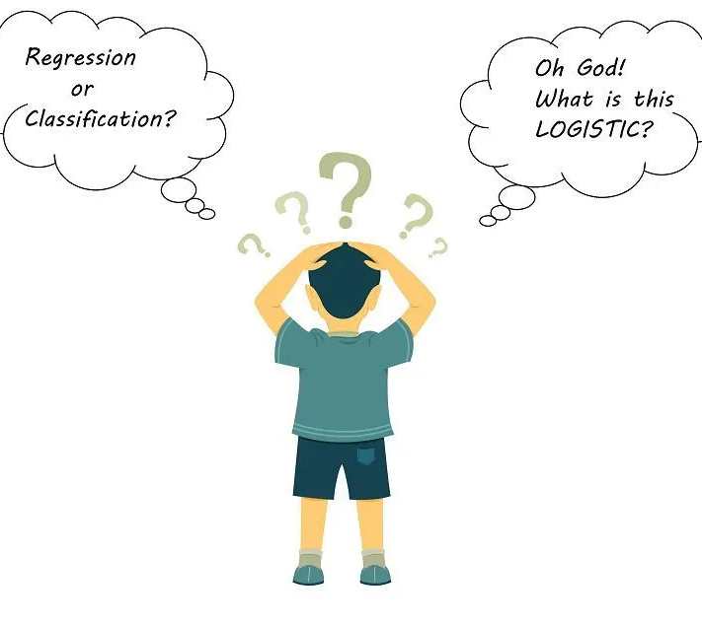
WHAT IS LOGISTIC REGRESSION?
A discriminative classification algorithm that produces a generalized linear model usually used for binary classification (although it can also perform multi-class classification).
Notes:
Discriminative means that the model is trained to focus only on the differences between the two classes, unlike a generative classifier that tries to understand the characteristics of each class.

Slide 11
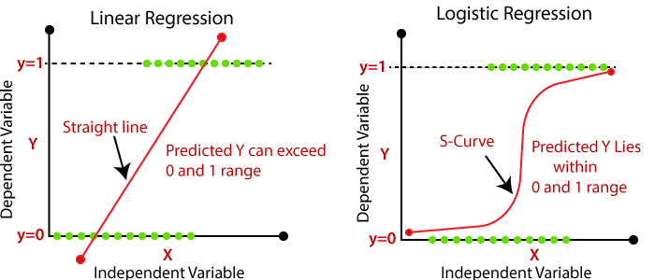
Why Not Linear Regression?
Notes:
Binary Classification: typically 0 = negative class (answer = no), 1 = positive class (answer = yes).
linear regression is basically the line of best fit.

Slide 12
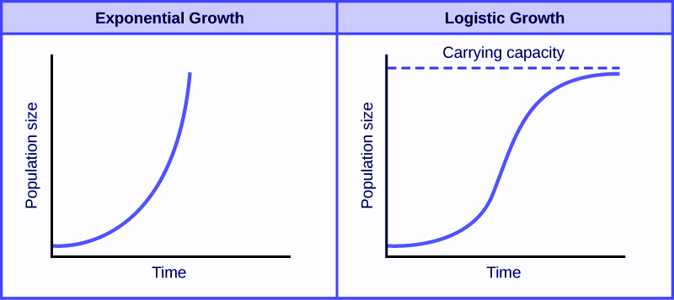
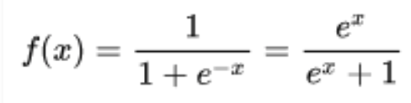
The Math
Logistic Equation Standard Form
Notes:
some of you in math class or biology class may have heard of logistic growth versus exponential growth: guess what, logistic regression uses basically the same function as the logistic equation you learn in class

Slide 13

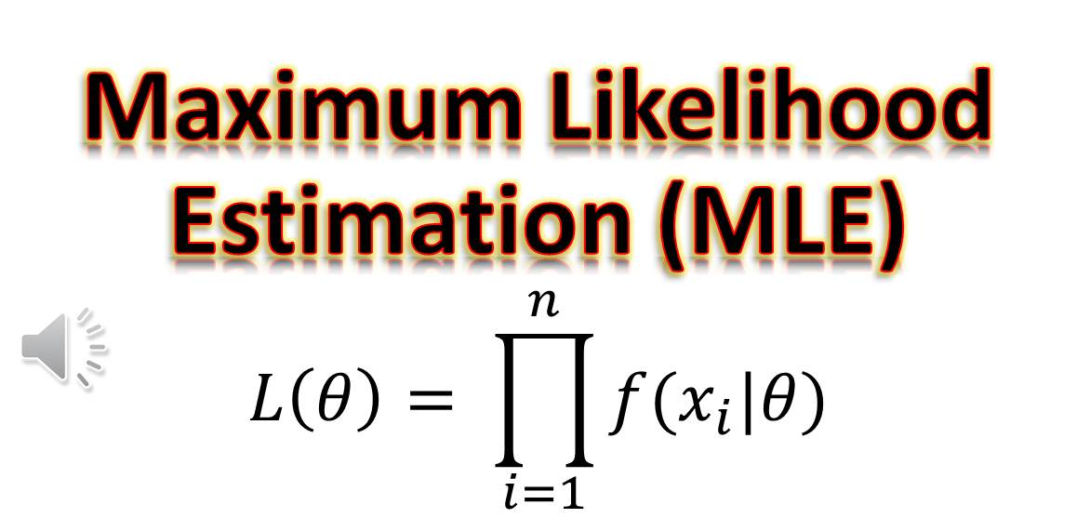
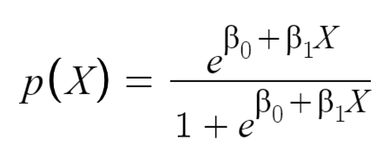
Math (Cont’d)
Linear Regression Function
Logistic Regression Function
Unknown Coefficients
Notes:
we used least squares to estimate the unknown linear regression coefficients, but for logistic regression we’ll use maximum likelihood estimation (MLE) because its more accurate (although mathematically speaking, least squares is just a special case of maximum likelihood, but let’s not get into that, it’s the math is too complicated). Basically, the maximum likelihood function estimates the coefficients.
So far the formulas I showed you are assuming you are doing binary classification with only 1 predictor, in reality you can do have multiple classes with multiple predictors (both continuous and categorica, for categorical you’ll have to use dummy variablesl) but I’m not going to show the mathematical models for that because multiple logistic regression is too complex.

Slide 14
03
Metrics

Slide 15
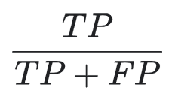
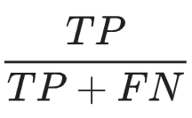
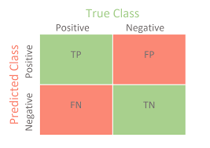
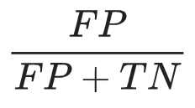


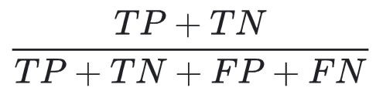

Precision
Metrics
Recall/Sensitivity (TPR)
Specificity (TNR)
FPR = 1 – TNR
Accuracy
Error rate
Number of correct positive predictions over total number of predicted positives. The higher the precision, the better.
Number of correct positive predictions over total number of actual positives. The higher the recall, the better. (A.K.A true positive rate.)
Measuring How Good/Bad Your Model Is
Confusion Matrix
Number of correct negative predictions over total number of actual negatives. The higher the specificity, the better.
Number of missed negative predictions over total number of actual negatives. The higher the precision, the better.
Number of correct classifications over total number of classifications made. The higher the accuracy, the better.
Number of false classifications over total number of classifications made. The lower the error rate the better. (A.K.A. misclassification rate.)
Notes:
remember 1 = positive. 0 = negative
If you graph these points (with precision on the y-axis and recall on the x-axis), you get a precision-recall curve (or equivalently, a precision-recall graph)
Unfortunately, precision and recall are often in tension (inversely related). You have to adjust the classification (i.e. what probability value is your cut-off) threshold to find the best balance.
Like precision/recall, specificity and sensitivity are also in tension (inversely related). Once again, you need to adjust the classification threshold to find the right balance.

Slide 16
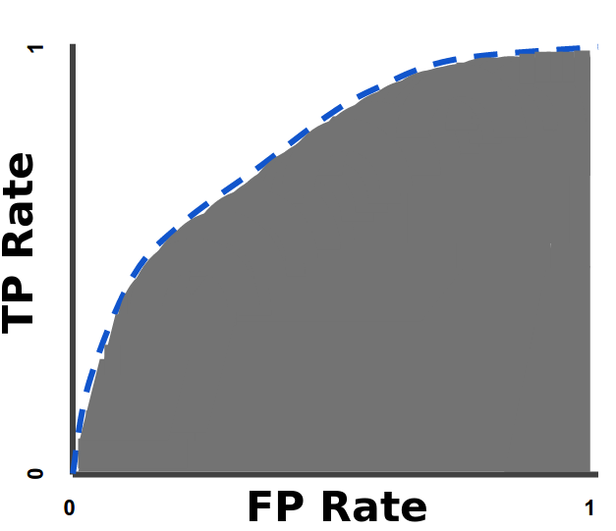
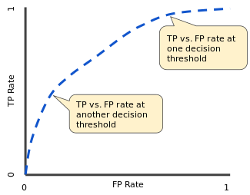
ROC & AUC
Receiver Operating Characteristic (ROC) Curve
Area Under the ROC Curve (AUC)
Graph of True Positive Rate (TPR) over False Positive Rate (FPR).
AUC measures the two-dimensional area underneath the entire ROC curve from (0,0) to (1,1). AUC ranges in value from 0 to 1. The higher the AUC, the more the model is capable of distinguishing between classes and predicting 0 classes as 0 and 1 classes as 1.
Notes:
Lowering the classification threshold classifies more items as positive, thus increasing both False Positives and True Positives.
I am not going to get deep into using ROC and AUC in this lecture because that’s just too much for one day, but for now, just know that it exists and that it’s one metric data scientists like to use to evaluate classification models.

Slide 17

Log Loss (Binary Cross-Entropy)
Others:
Prediction Bias
Bias Term
A function that measures the performance of a classification model whose output is a probability value between 0 and 1.
A perfect model would have a log loss of 0. You must try to minimize the loss function (it’s never negative).
Log loss function = –1 x the log of the likelihood function
Cost function for N samples in training set
y = actual label of i’th sample
p(y) = predicted probability
Notes:
Use Log Loss for logistic regression (MSE for linear regression).
Cost function is just the average of the loss functions for all samples.

Slide 18
04
Implementation

Slide 19
THANKS

